Slide 1

AY2026/27 Student Finance
Head of Student Finance AR – Laura Hill
Fed Aid Officer – Barry Finnegan

Slide 2
Student Finance
Fees, Sponsorships & Federal Aid
Student Finance
Fees, payments, sponsorships and refunds
Federal Aid
Eligibility, what it is, programmes and funding limits
Key Messages
Know what you owe, when, how and if Federal Aid can contribute

Slide 3
What Student Finance (SF) does…
One of the core services in the Academic Registry (AR)
Raises fee invoices at the start of academic year
Administers sponsorships and transfers fee liability where a third party funds all / part of fees
Collects fees due from students and third parties – including public or private sponsors
Processes refunds, including Erasmus, hardship payments and overpayments
Online Information
https://www.tcd.ie/academicregistry/assets/PDF/fees-and-payments/
Notes:
Left out what the website does – use the sticky tab as a pointer to direct students to the website for latest guidance

Slide 4
Registration, Invoices & Sponsorships
When invited to register, log into my.tcd.ie portal and complete all registration tasks.
Financial task provides breakdown of fees and fee category.
Students can choose to pay in full or instalments.
Approved third party can fund fees (sponsors)
Students can amend payer details on invoice where applicable.
HEA, HSE, SUSI
etc
Sponsorship does not automatically mean every fee is covered

Slide 5

Paying the bill
Use 8-digit student number on correspondence with Trinity
Outstanding debt
Check SF website
Domestic Students (EU & UK)
Pay online by card. EFT payments are accepted only by exception.
International Students
TransferMate which supports EFT
Payment Timing
Students may pay in full or use the instalment option

Slide 6

Federal Aid Eligibility
US citizen OR eligible non-citizen with Social Security number
Eligibility depends on meeting the relevant Federal Aid requirements
Some programmes are not approved for Federal Aid
Federal Student Aid website

Slide 7
Federal Aid – Programme Restrictions & Funding
Programmes not approved for Federal Aid
How much can I receive?
Study Abroad
All nursing programmes – postgraduate and undergraduate
Certificate or diploma courses
Correspondence, distance, or online courses
Dual BA Programme with Columbia
Total Federal Aid + private loans / scholarships / funding
COA includes college-determined estimated costs and fees / tuition
Students may borrow up to the value of their COA
Notes:
Reminder to first establish eligibility and programme approval; then consider the Cost of Attendance and the overall funding already available to the student.

Slide 8
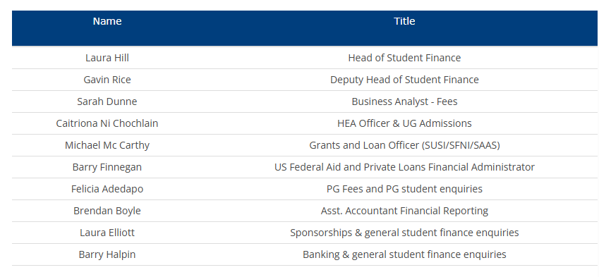
Finally…
If you have any queries, you can contact Student Finance via HALO email address ARStudentFinance@tcd.ie

Slide 9


Thank You!
Questions?

